Slide 1


PHISHING EMAIL TRAFFIC DETECTION AWARENESS
NAME: Tony Winston T N Jaianiruth Abinayasri K
REG. NO: 1924260006 1911260130 1921260133
COURSE NAME: COMPUTER NETWORKS
COURSE CODE: CSA0704
SLOT: A
GUIDED BY: Dr.JAI SHARMA K

Slide 2
Table of Contents
ABSTRACT
INTRODUCTION
PROBLEM STATEMENT
PROPOSED SOLUTION
SYSTEM ARCHITECTURE
MODULE 1
MODULE 2
MODULE 3
SOFTWARE/HARDWARE FUNCTIONALITY
RESULT AND COMPARISON
LIMITATIONS
FUTURE SCOPE
CONCLUSION

Slide 3
Abstract
Phishing emails are a common cybersecurity threat that attempt to trick users into revealing sensitive information.
This project demonstrates basic techniques for identifying suspicious email traffic.
A controlled email environment is used to simulate normal and suspicious traffic.
Wireshark is used to analyze network-visible email traffic and identify suspicious patterns.
A Python keyword-based detection script is developed to flag emails containing common phishing-related terms.
The project provides a simple approach to understanding how phishing traffic can be detected.

Slide 4
Introduction
What is Phishing?
Phishing is a cyberattack where attackers pretend to be trustworthy individuals or organizations.
The main objective is to make users reveal confidential information.
Phishing commonly occurs through emails, messages, and fake websites.
Suspicious emails may contain:
Urgent requests
Fake account warnings
Suspicious links
Requests for personal information
Unusual sender addresses
Why is Detection Important?
Protects users from cyberattacks.
Improves cybersecurity awareness.
Helps identify suspicious communication.
Reduces the risk of credential theft and financial fraud.

Slide 5
Problem Identification and Analysis
Problem Statement
Users often receive emails that appear legitimate but may contain phishing characteristics.
The problem is to develop a simple experimental system that can:
Simulate normal and suspicious email traffic.
Observe network traffic generated by emails.
Identify suspicious traffic patterns.
Detect common phishing-related keywords.
Provide awareness of basic phishing detection techniques.
Existing Problem
Traditional users may not recognize suspicious emails because phishing messages can look similar to legitimate emails.

Slide 6
Proposed Solution
Three-Module Solution
The project is divided into three independent modules:
Module 1 –
Controlled Email Traffic Simulation
Creates a controlled environment containing:
Normal email traffic
Suspicious email traffic
Module 2 –
Wireshark-Based Pattern Analysis
Captures and analyzes network traffic to identify:
Email protocols
Headers
Suspicious patterns
Network-visible indicators
Module 3 –
Basic Keyword-Based Detection Script
Uses Python to:
Read email subject/text
Search for phishing-related keywords
Flag suspicious emails

Slide 7
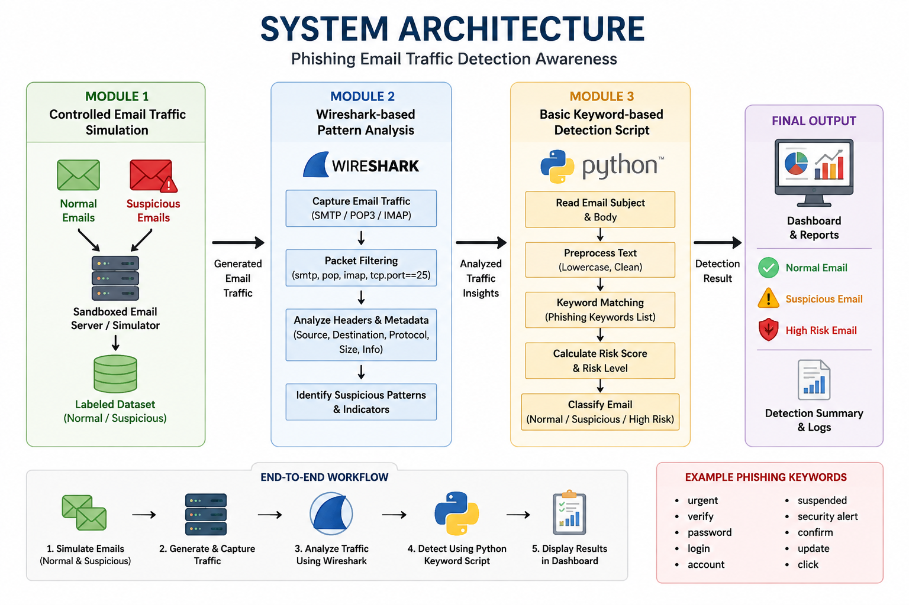

Slide 8
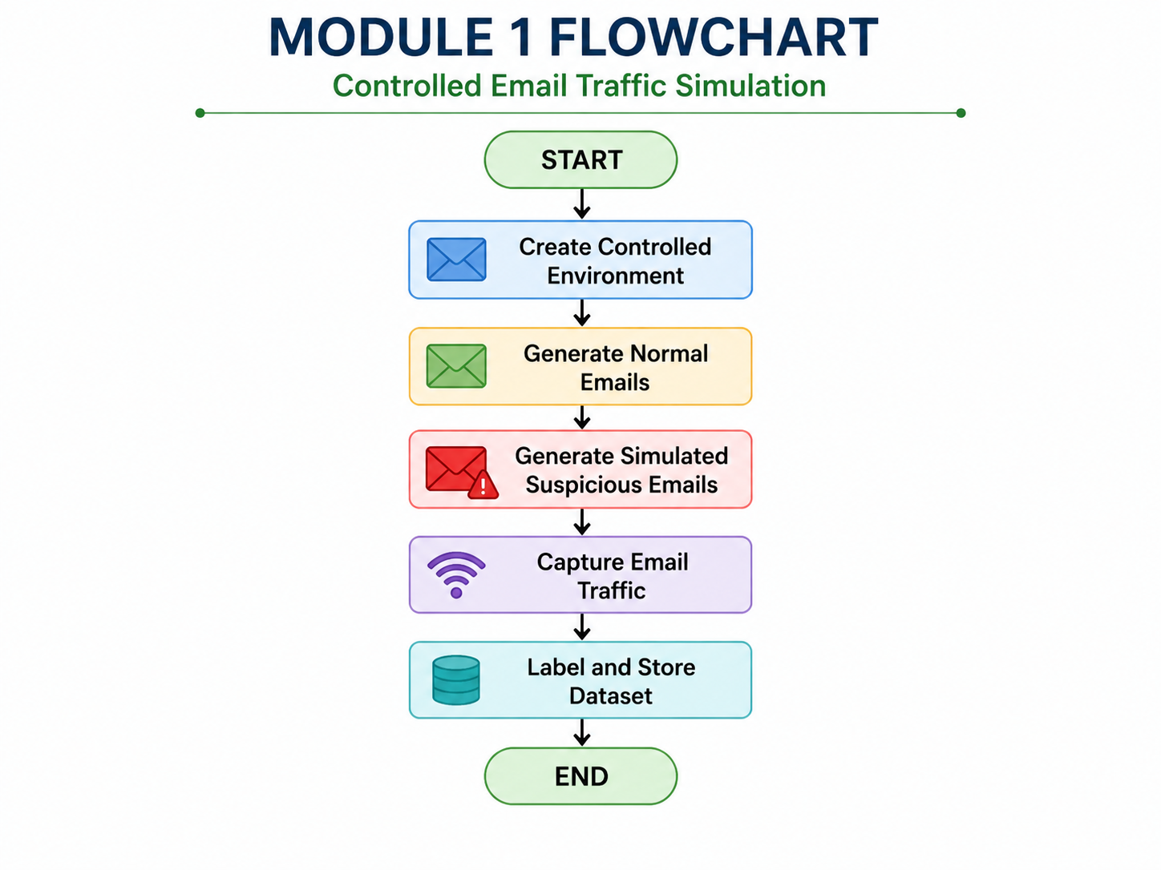
Module 1: Controlled Email Traffic Simulation
Objective:
Create a controlled environment to simulate normal and suspicious email traffic.
Tasks
Generate normal email traffic.
Generate simulated suspicious email traffic.
Record email-related traffic.
Create a labelled dataset.
Maintain controlled laboratory conditions.
Tools
Sandboxed email server/simulation
Controlled lab environment
Network traffic capture
Output
Labelled dataset containing normal and suspicious email traffic.

Slide 9
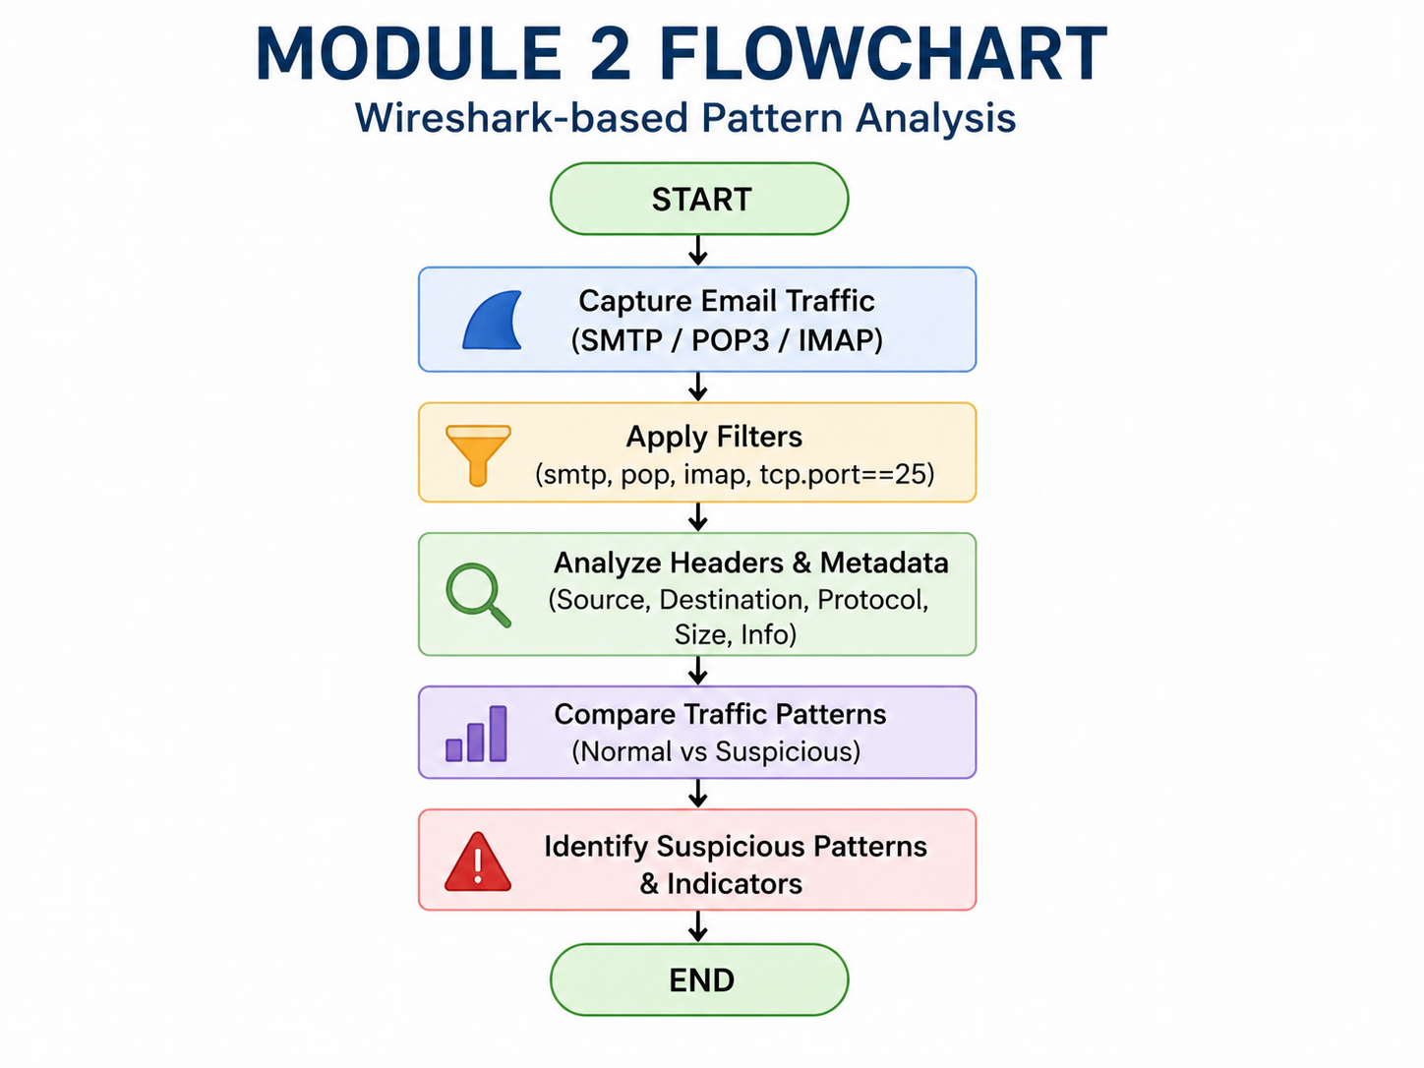
Module 2: Wireshark-Based Pattern Analysis
Objective:
Analyze captured email traffic using Wireshark.
Tasks
Capture network packets.
Identify email-related protocols.
Compare normal and suspicious traffic.
Examine available headers and network metadata.
Identify suspicious network-visible indicators.
Tools
Wireshark
Protocols
SMTP – Sending email
POP3 – Receiving email
IMAP – Accessing email
Output
A documented list of network-visible characteristics that may help distinguish suspicious traffic.

Slide 10
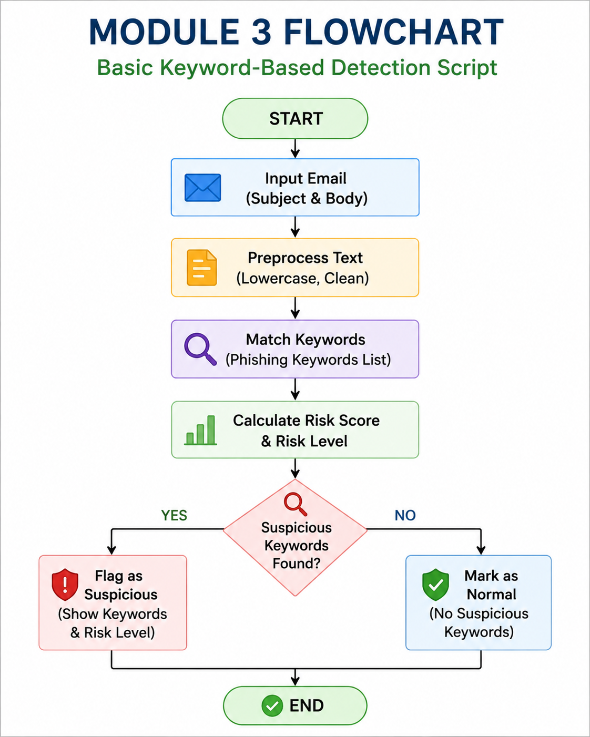
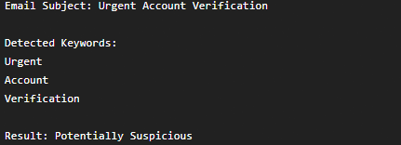
Module 3: Basic Keyword-Based Detection
Objective: Develop a simple Python program that identifies potentially suspicious emails using keywords.
Method
Read email subject and text.
Convert text into a common format.
Search for predefined keywords.
Count matching keywords.
Flag emails containing suspicious terms.
Output

Slide 11
Software / Hardware Functionality
Software | Purpose
Wireshark | Network traffic capture and analysis
Python | Keyword-based detection
Email simulation environment | Generate controlled traffic
Operating System | Run project tools
Hardware Requirements
Laptop/Desktop
Minimum 4 GB RAM
Network interface
Internet/LAN connection where required
Sufficient storage for packet captures
Functionality
Capture → Analyze → Detect → Report

Slide 12
Results and Comparison
Module-wise Results
MODULE | INPUT | TECHNIQUE | OUTPUT
MODULE 1 | Email Traffic | Simulation | Labelled Traffic Dataset
MODULE 2 | Captured packets | Wireshark | Suspicious traffic indicators
MODULE 3 | Email text | Python keywords | Suspicious / Normal classification
Overall Result
The three modules demonstrate different levels of phishing detection:
Traffic Generation → Network Analysis → Content-Based Detection

Slide 13
Limitations
Keyword detection can produce false positives.
New phishing techniques may use different words.
Encrypted email traffic limits packet-level visibility.
Wireshark analysis requires basic networking knowledge.
Controlled simulation may not represent every real-world attack.
The project does not use advanced machine learning.

Slide 14
Future Scope
Future Enhancements
Machine learning-based phishing detection.
Natural Language Processing (NLP).
URL reputation checking.
Sender/domain reputation analysis.
Automated email classification.
Real-time monitoring dashboard.
Integration with security systems.
Improved detection using multiple indicators.

Slide 15
Conclusion
Phishing is an important cybersecurity threat that requires user awareness and technical detection.
This project demonstrates three complementary approaches.
Module 1 creates controlled email traffic.
Module 2 analyzes network traffic using Wireshark.
Module 3 detects suspicious keywords using Python.
The project helps students understand both network-level and content-level phishing indicators.
The system can be extended using machine learning, NLP, URL analysis, and real-time monitoring.
Final Message
“Awareness + Analysis + Detection = Better Protection Against Phishing”

Slide 16
References
Wireshark Documentation – Network Protocol Analyzer
Python Documentation – Python Programming Language
RFC 5321 – Simple Mail Transfer Protocol (SMTP)
RFC 3501 – Internet Message Access Protocol (IMAP)
RFC 1939 – Post Office Protocol Version 3 (POP3)
CISA – Phishing Guidance and Cybersecurity Awareness
NIST – Cybersecurity Framework
OWASP – Web and Application Security Resources

Slide 17
THANK YOU

